Slide 1

LUA PROGRAMMING LANGUAGE
Davide Perticone

Slide 2
HISTORY OF LUA
Started as in-house project in 1993 by Roberto Ierusalimschy, Luiz Henrique de Figueiredo, and Waldemar Celes.
Lua is designed, implemented, and maintained by a team at PUC-Rio, the Pontifical Catholic University of Rio de Janeiro in Brazil.
Designed from the beginning to be a software that can be integrated with the code written in C
It does not try to do what C can already do but aims at offering what C is not good:
Good distance from hardware
Dynamic data structures
Ease of testing and debugging

Slide 3
Some Uses of Lua:
Game Programming (CryEngine, Angry Birds, World of Warcraft…)
Scripting in Standalone Applications (Adobe’s Photoshop Lightroom)
Scripting in Web
Extensions and add-ons for databases like MySQL Proxy and
MySQL WorkBench
Security systems like Intrusion Detection System.

Slide 4
Basics of Lua
What does it mean Lua? Is it a noun?
"Lua" (pronounced LOO-ah) means "Moon" in Portuguese.
Is Lua fast?
Lua has a deserved reputation for performance. To claim to be "as fast as Lua" is an aspiration of other scripting languages.
Is Lua compiled or interpreted?
Lua programs are not interpreted directly from the textual Lua file, but are compiled into bytecode, which is then run on the Lua virtual machine. The compilation process is typically invisible to the user and is performed during run-time. Then, Lua bytecode is interpreted. For the end-user, Lua can be considered as an interpreted language, but looking closely, it is compiled (and then interpreted).
What is a chunk in Lua?
Each piece of code that Lua executes, such as a file or a single line in interactive mode, is a chunk. More specifically, a chunk is simply a sequence of statements.

Slide 5
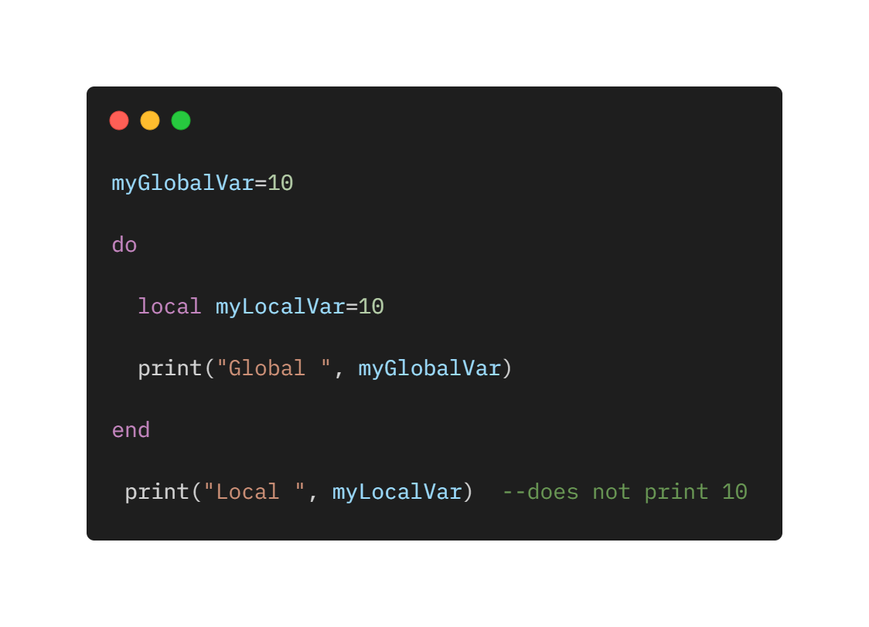
Variables
Global variables: all variables are considered global unless explicitly declared as a local.
Local variables: when the type is specified as local for a variable then its scope is limited with the functions inside their scope.

Slide 6
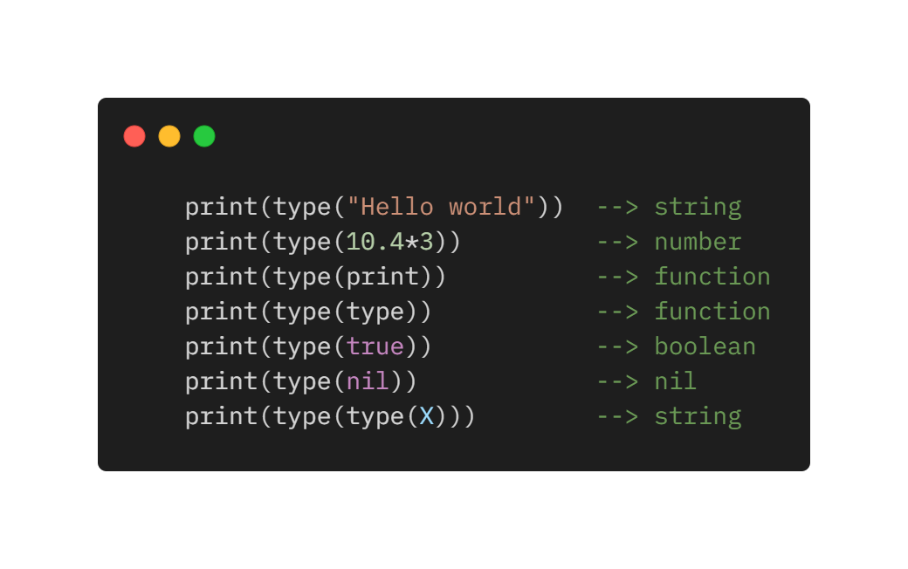
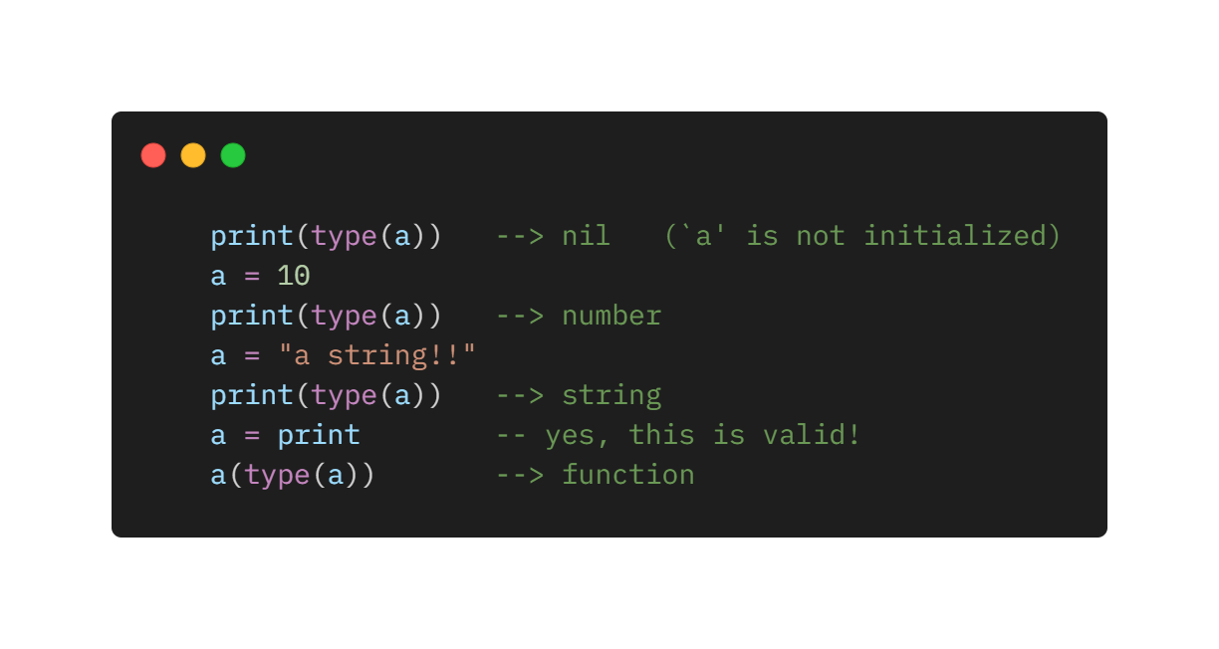
Types and Values
Lua is a dynamically typed language. There are no type definitions in the language; each value carries its own type.
Eight basic types in Lua: nil, boolean, number, string, userdata, function, thread, and table.
Variables have no predefined types; any variable may contain values of any type-
Notice the last two lines: Functions are first-class values in Lua; so, we can manipulate them like any other value.

Slide 7
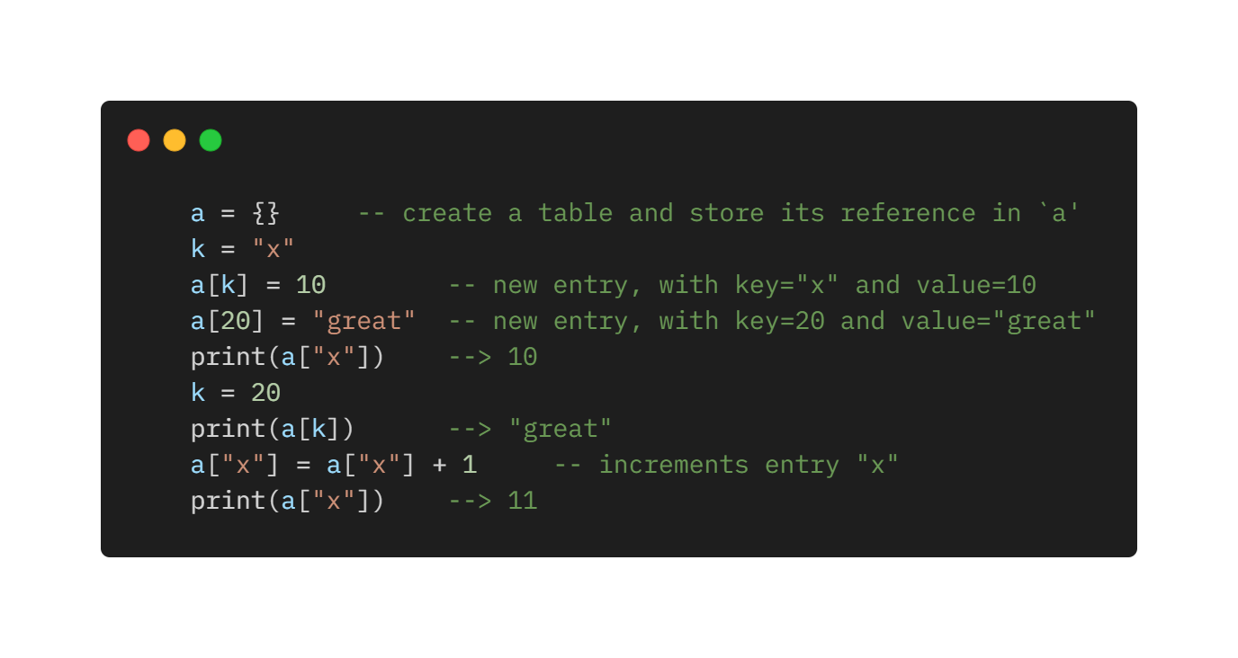
Tables
The table type implements associative arrays. An associative array is an array that can be indexed not only with numbers, but also with strings or any other value of the language, except nil.
Tables are the main (in fact, the only) data structuring mechanism in Lua, and a powerful one.
They are used to:
Represent ordinary arrays
Symbol tables
Sets
Records
Queues
Many other data structures.
Tables in Lua are neither values nor variables; they are objects. Same concept of Hava

Slide 8
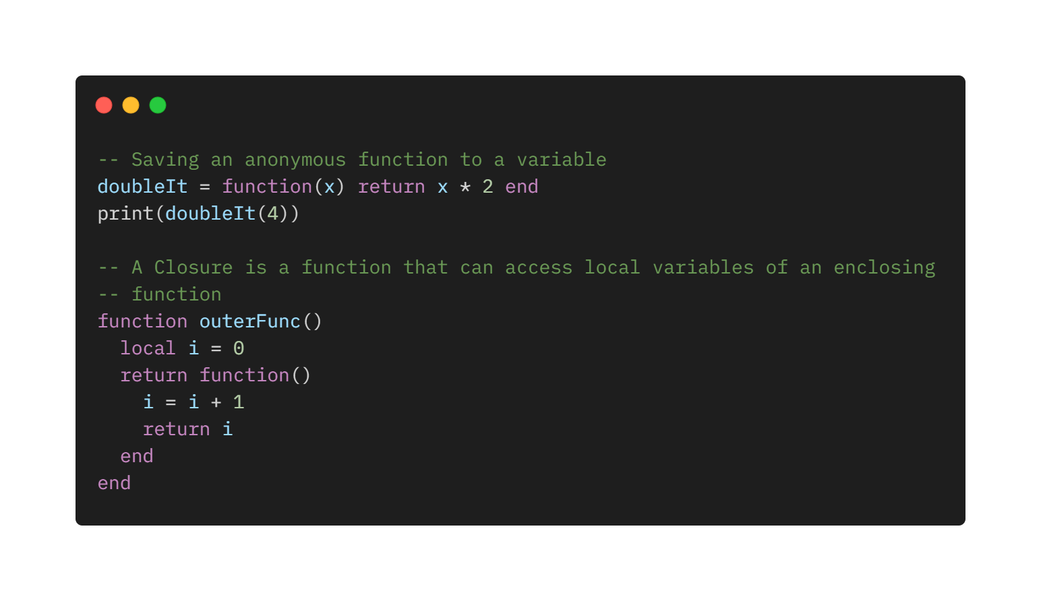
Functions
Functions are first-class values in Lua. That means that functions can be stored in variables, passed as arguments to other functions, and returned as results.
Lua can call functions written in Lua and functions written in C. All the standard library in Lua is written in C. Application programs may define other functions in C.

Slide 9
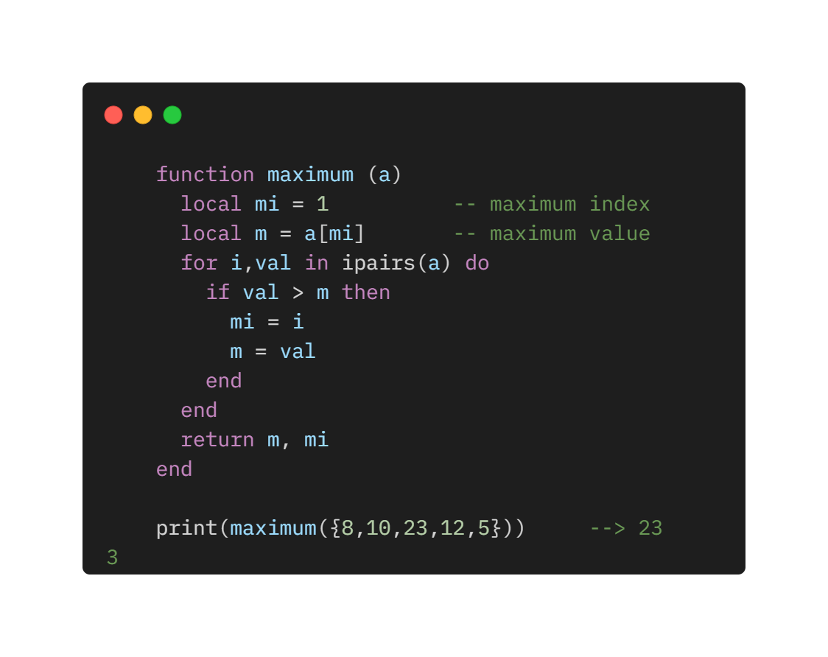
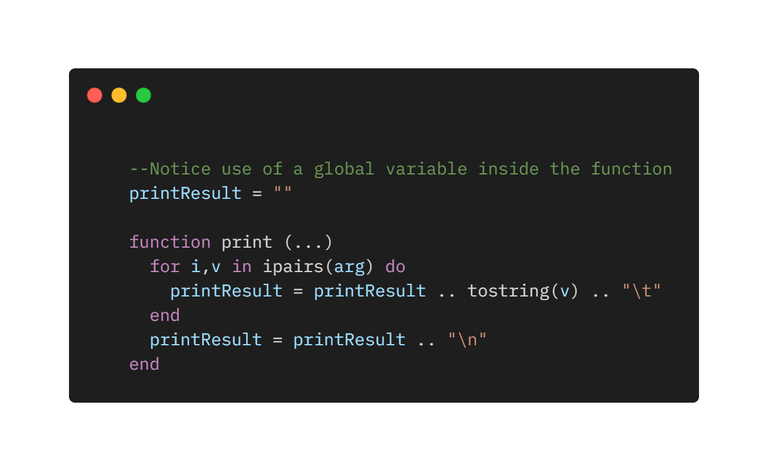
Multiple Results - Variable Number of arguments
The three dots (...) in the parameter list indicate that the function has a variable number of arguments. When this function is called, all its arguments are collected in a single table, which the function accesses as a hidden parameter named arg. Besides those arguments, the arg table has an extra field, n, with the actual number of arguments collected.
Functions written in Lua also can return multiple results, by listing them all after the return keyword.

Slide 10
About Functions
Functions in Lua are first-class values with proper lexical scoping.
What does it mean for functions to be "first-class values"? It means that, in Lua, a function is a value with the same rights as conventional values like numbers and strings. Functions can be stored in variables (both global and local) and in tables, can be passed as arguments, and can be returned by other functions.
What does it mean for functions to have "lexical scoping"? It means that functions can access variables of its enclosing functions.

Slide 11
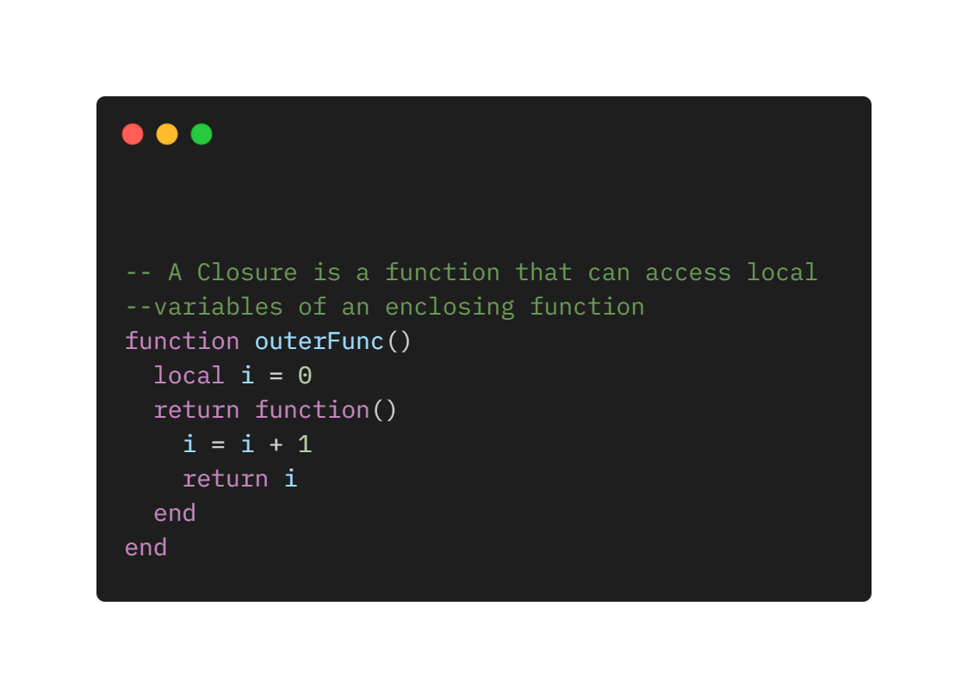
Closures
When a function is written enclosed in another function, it has full access to local variables from the enclosing function; this feature is called lexical scoping.
A closure construction typically involves two functions: the closure itself; and a factory, the function that creates the closure
Example next slide

Slide 12
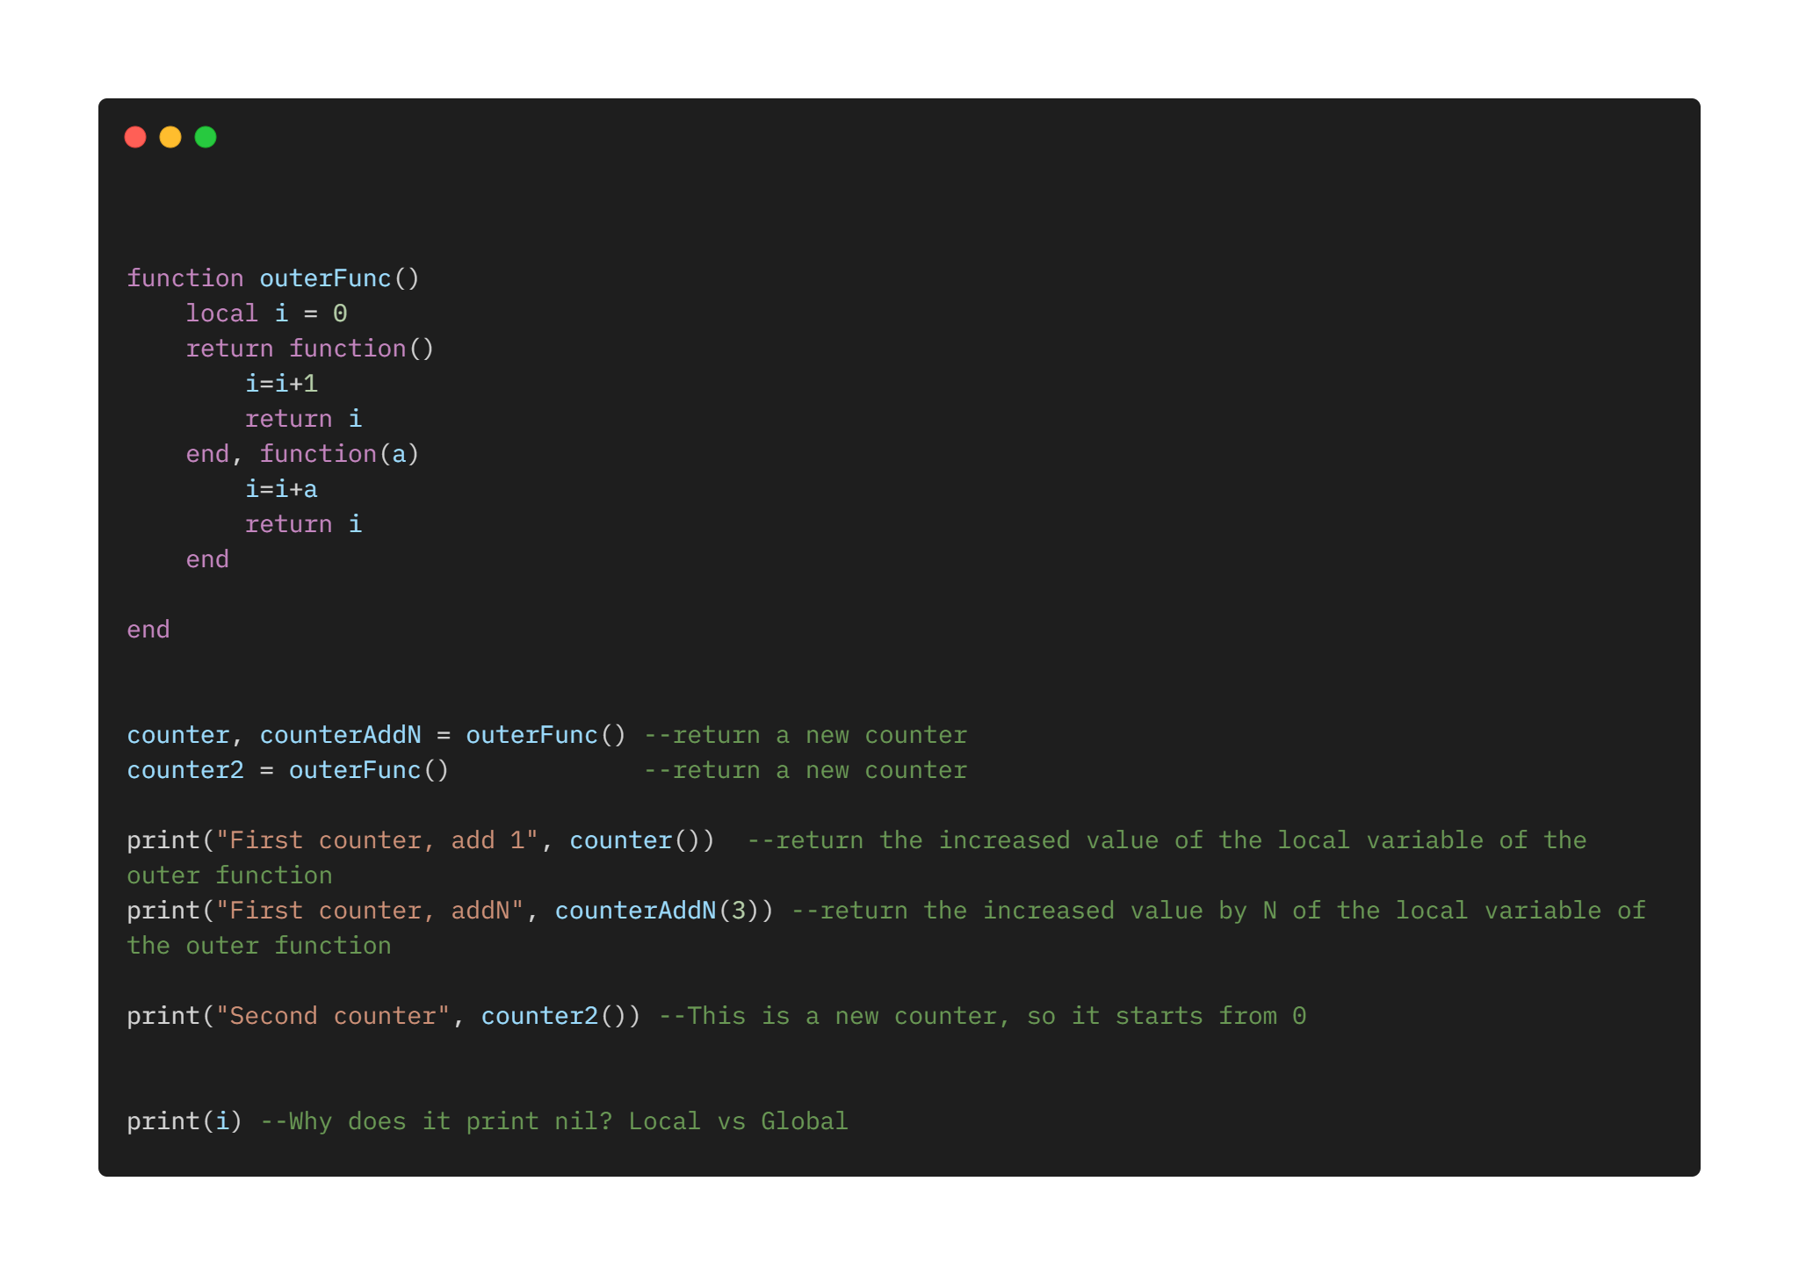
Running example FuncClos.lua

Slide 13
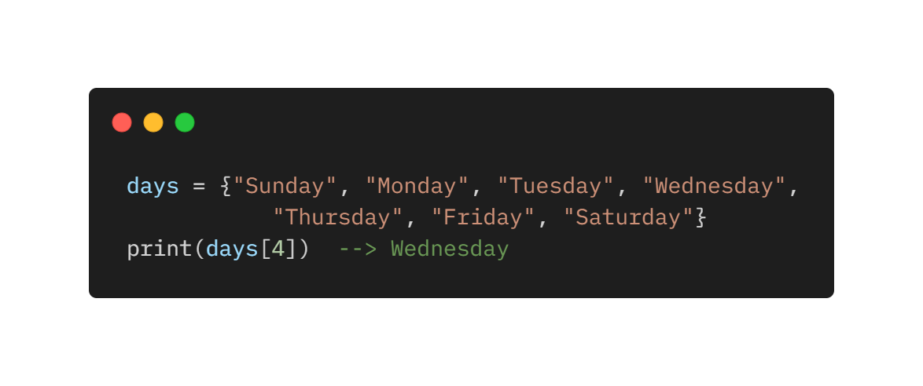
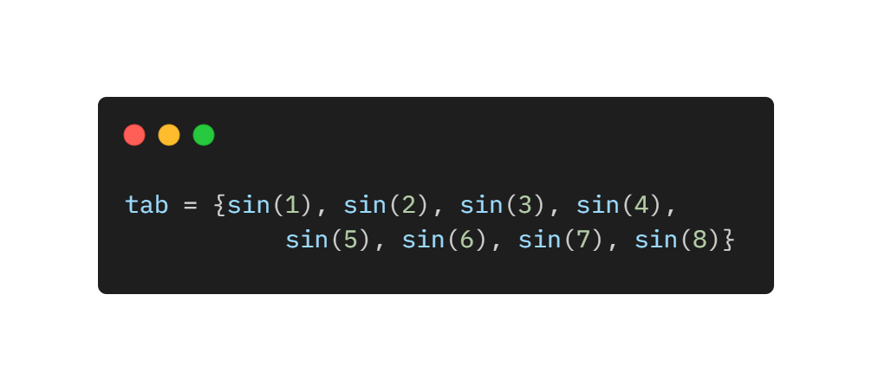
Constructors
Constructors are expressions that create and initialize tables. They are a distinctive feature of Lua and one of its most useful and versatile mechanisms. The constructor initializes days[1] with “Sunday”
Constructors do not need to use only constant expressions.

Slide 14
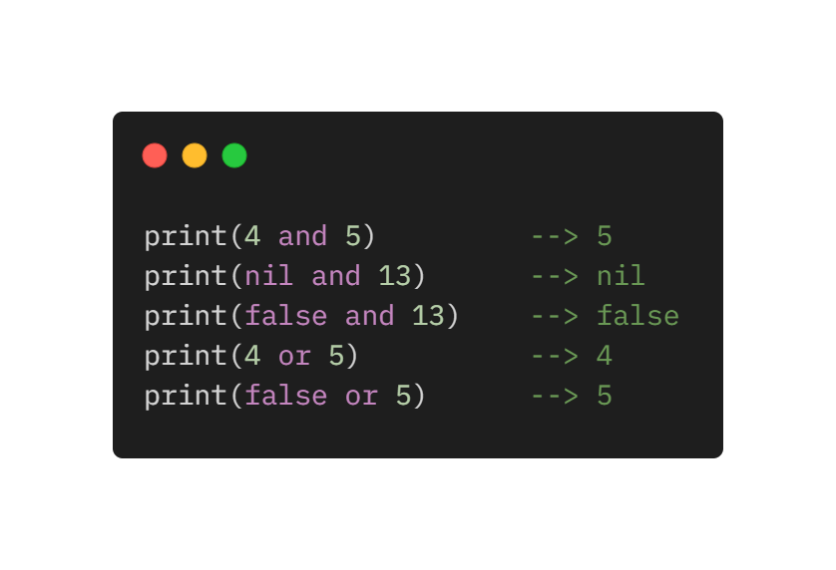
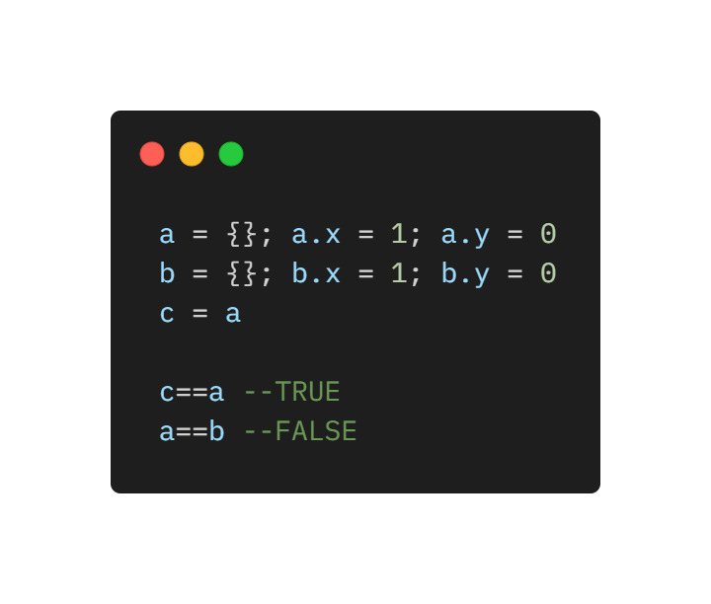
Expressions
Arithmetic operations: `+´ (addition), `-´ (subtraction), `*´ (multiplication), `/´ (division), and the unary “-” (negation), ^ (just syntax to maintain simplicity, library gives meaning)
Relational Operators: < > <= >= == ~= All these operators always result in true or false
Lua compares tables, userdata, and functions by reference, that is, two such values are considered equal only if they are the very same object.
The logical operators are and, or, and not. Like control structures, all logical operators consider false and nil as false and anything else as true
The operator and returns its first argument if it is false; otherwise, it returns its second argument. The operator or returns its first argument if it is not false; otherwise, it returns its second argument

Slide 15
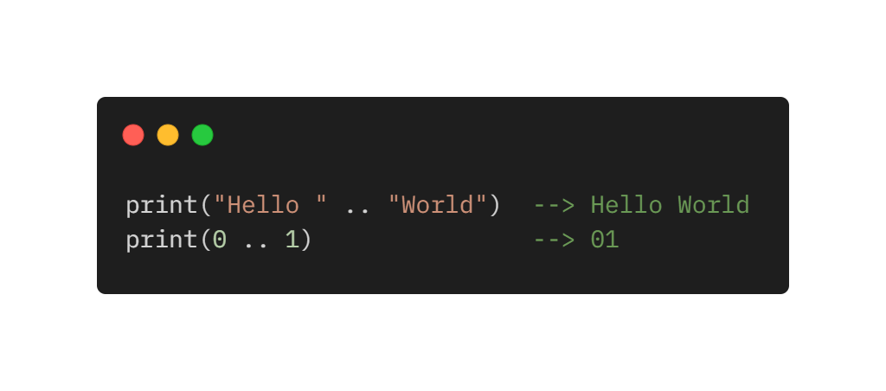
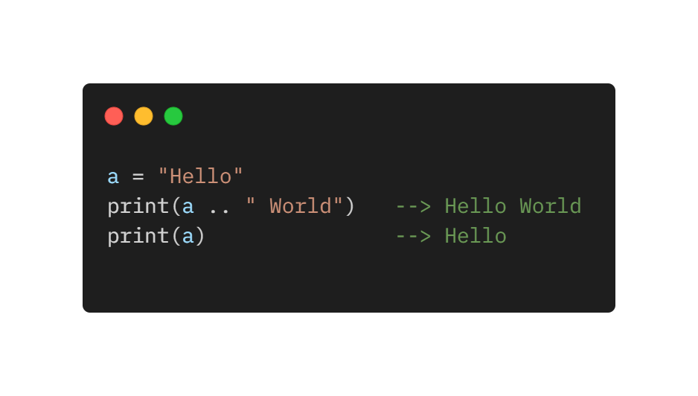
Expressions cond.
Lua denotes the string concatenation operator by ".." (two dots). If any of its operands is a number, Lua converts that number to a string.
Strings in Lua are immutable values. The concatenation operator always creates a new string, without any modification to its operands:

Slide 16
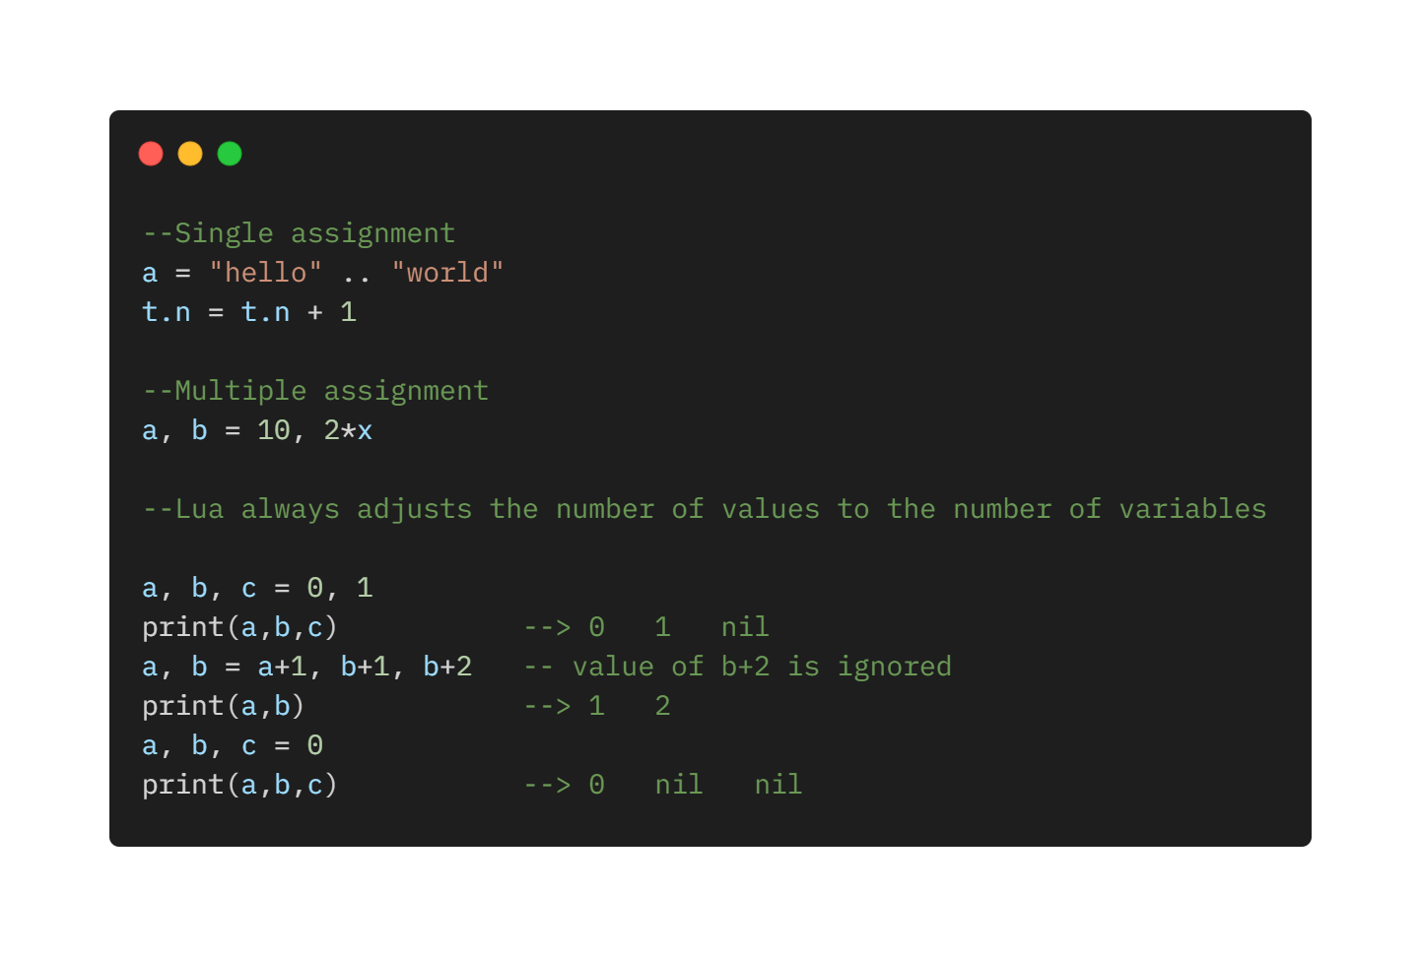
Assignment

Slide 17
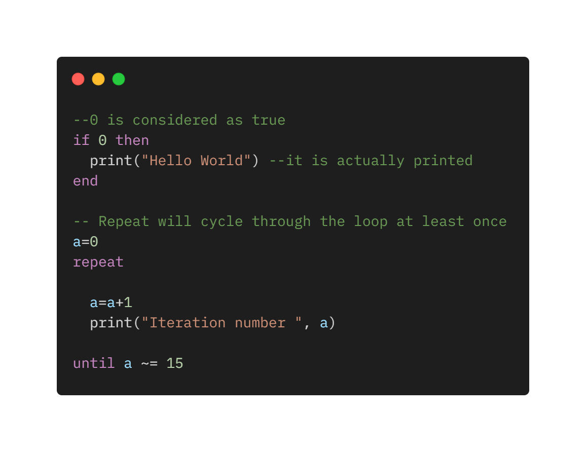
Control Structures
If else elsif for – conditional structures
while, repeat untilm for – iteration structures
All control structures have an explicit terminator: end terminates the if, for and while structures; and until terminates the repeat structure.
The condition expression of a control structure may result in any value. Lua treats as true all values different from false and nil.

Slide 18
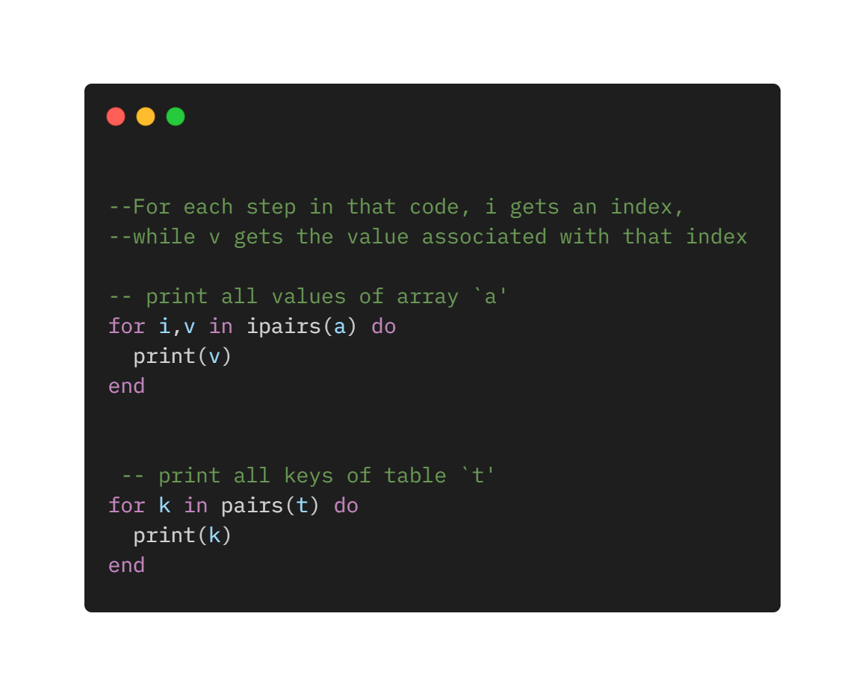
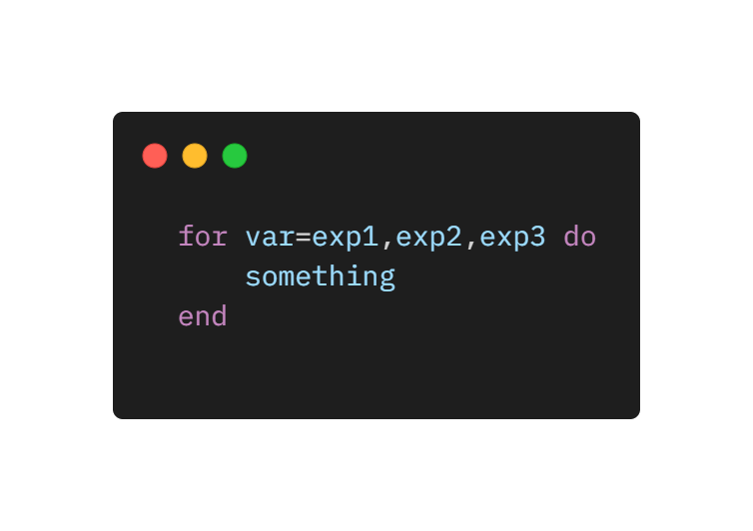
Numeric for – Generic for
The for statement has two variants: the numeric for and the generic for.
A numeric for has the following syntax:
for var=exp1,exp2,exp3 do
something
end
That loop will execute something for each value of var from exp1 to exp2, using exp3 as the step to increment var. This third expression is optional; when absent, Lua assumes one as the step value.
The generic for loop allows you to traverse all values returned by an iterator function.

Slide 19
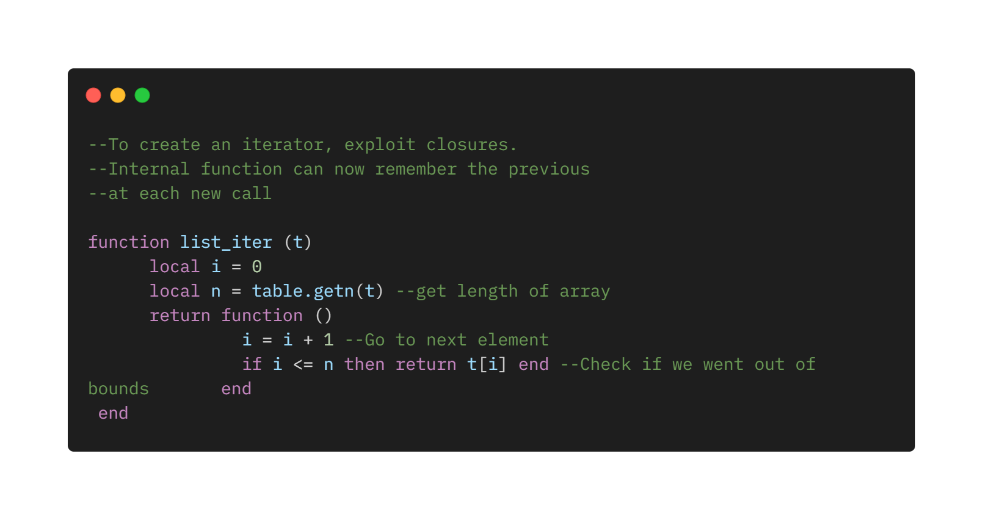
Iterators
An iterator is any construction that allows you to iterate over the elements of a collection. Lua represents iterators by functions: Each time we call that function, it returns a "next" element from the collection.

Slide 20
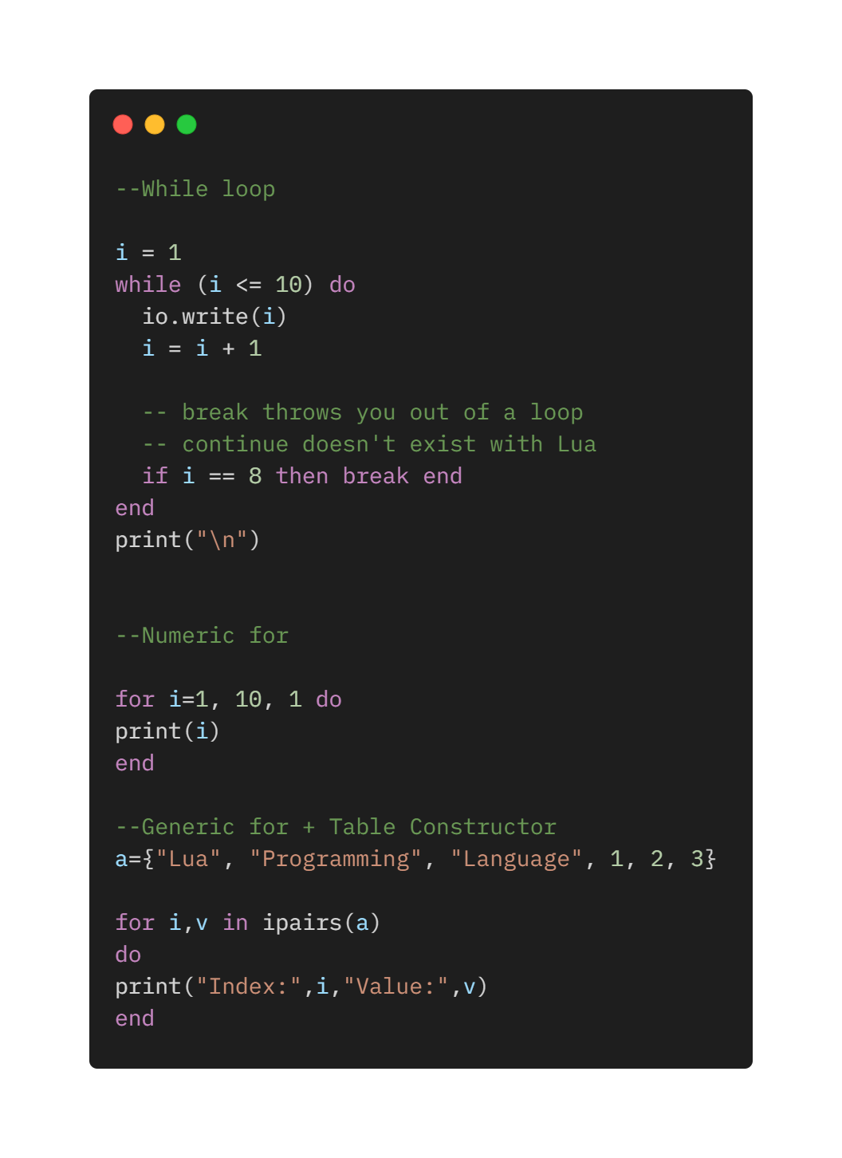
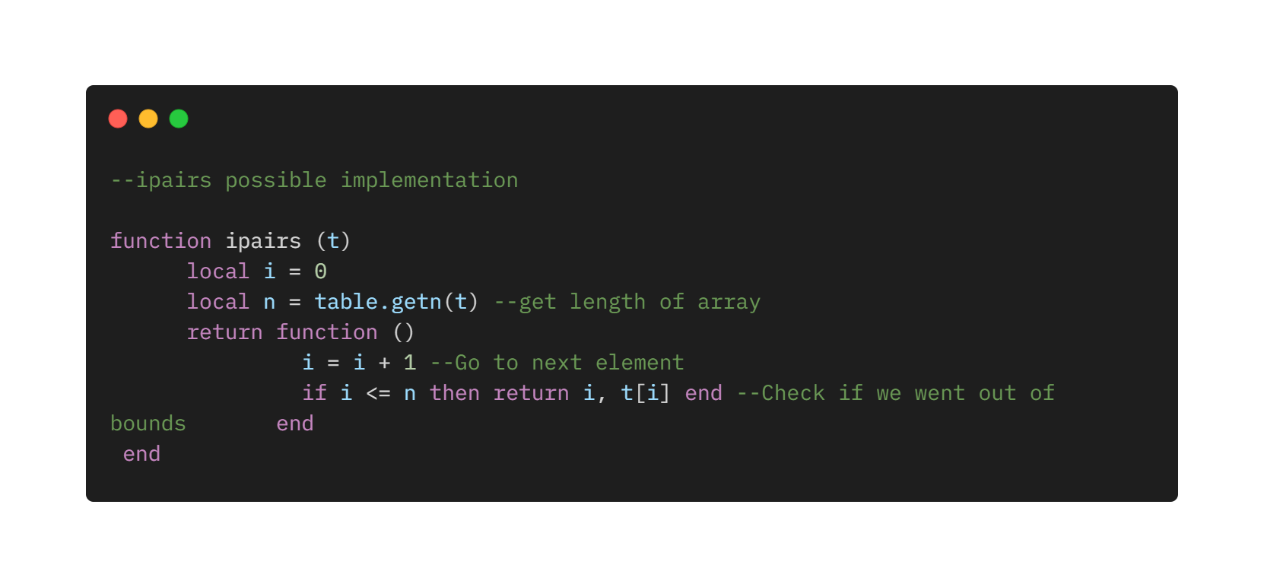
Running example LoopExample.lua

Slide 21
The require Function
Lua offers a higher-level function to load and run libraries, called require. First require searches for the file in a path; second, require controls whether a file has already been run to avoid duplicating the work. Because of these features, require is the preferred function in Lua for loading libraries.

Slide 22
Coroutines
Lua offers all its coroutine functions packed in the coroutine table. The create function creates new coroutines. It has a single argument, a function with the code that the coroutine will run. It returns a value of type thread, which represents the new coroutine. Quite often, the argument to create is an anonymous function.
A coroutine can be in one of three different states: suspended, running, and dead. When we create a coroutine, it starts in the suspended state. That means that a coroutine does not run its body automatically when we create it.
Coroutines are like threads except that they can't run in parallel.
Coroutines are non-preemptive. They cannot be stopped from outside.

Slide 23
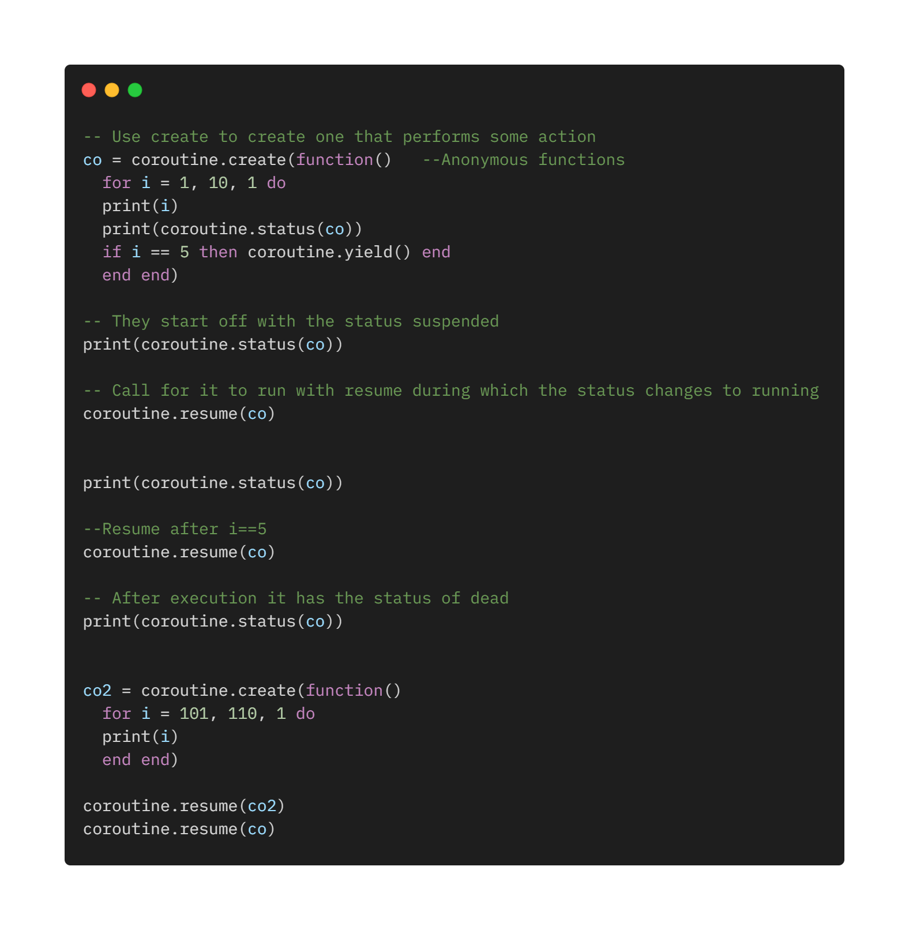
Running Example Coroutines.lua

Slide 24
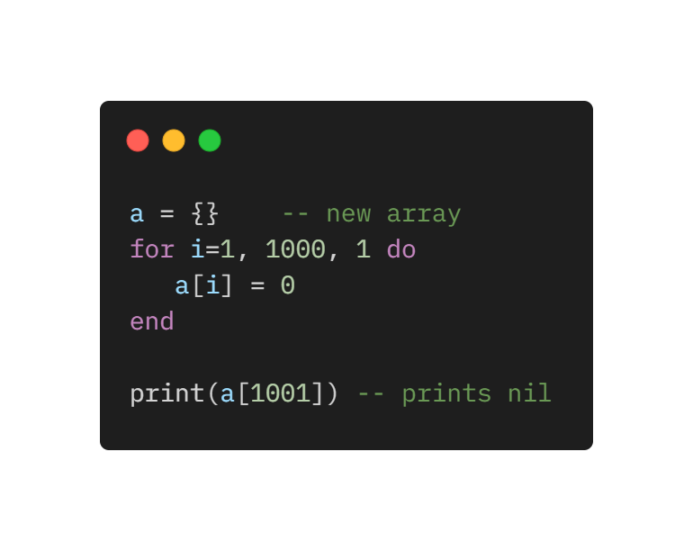
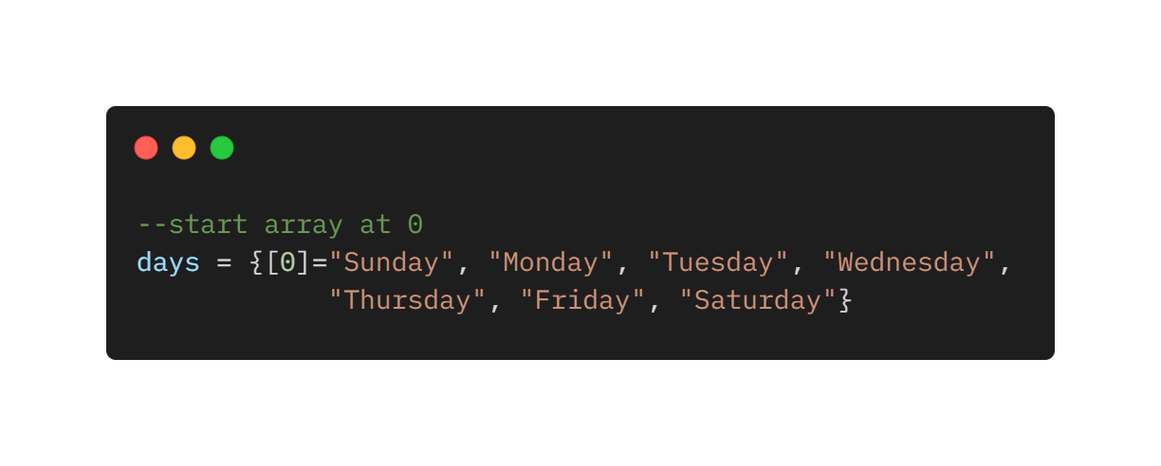
Arrays
Lua implements arrays simply by indexing tables with integers. Therefore, arrays do not have a fixed size, but grow as needed. When initializing an array, the size is defined indirectly.
Arrays start always from 1 instead of 0 if not otherwise specified.
The Lua libraries adhere to this convention. It is possible to use library functions
Directly If arrays start from 1.

Slide 25
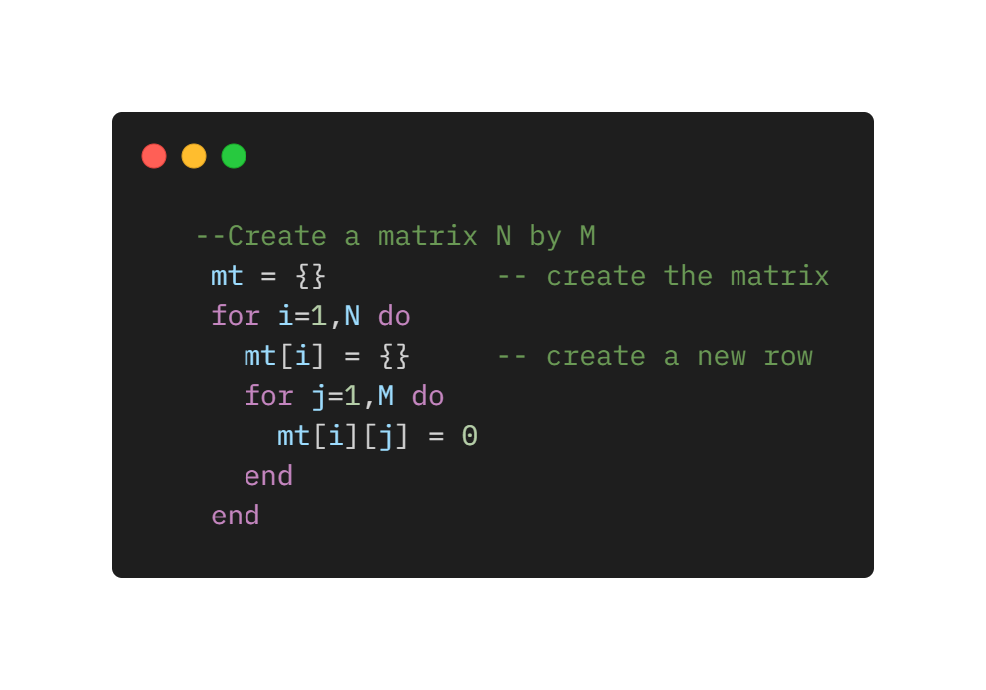
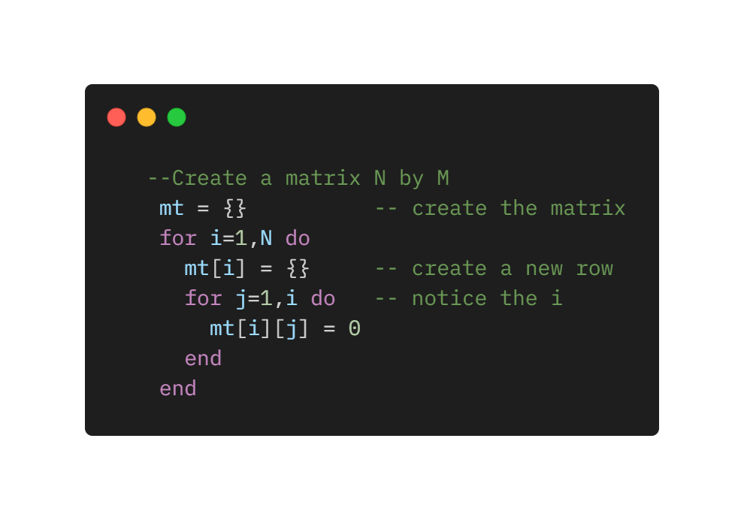
Matrices
There are no direct methods to construct matrices in Lua. The easiest way is to use arrays of arrays, that is a table wherein each element is another table.
On the one hand, this is certainly more verbose than simply declaring a matrix, as you do in C or Pascal. On the other hand, that gives you more flexibility. For instance, you can create a triangular matrix.
In this way, the triangular matrix saves half the space of a normal matrix.

Slide 26
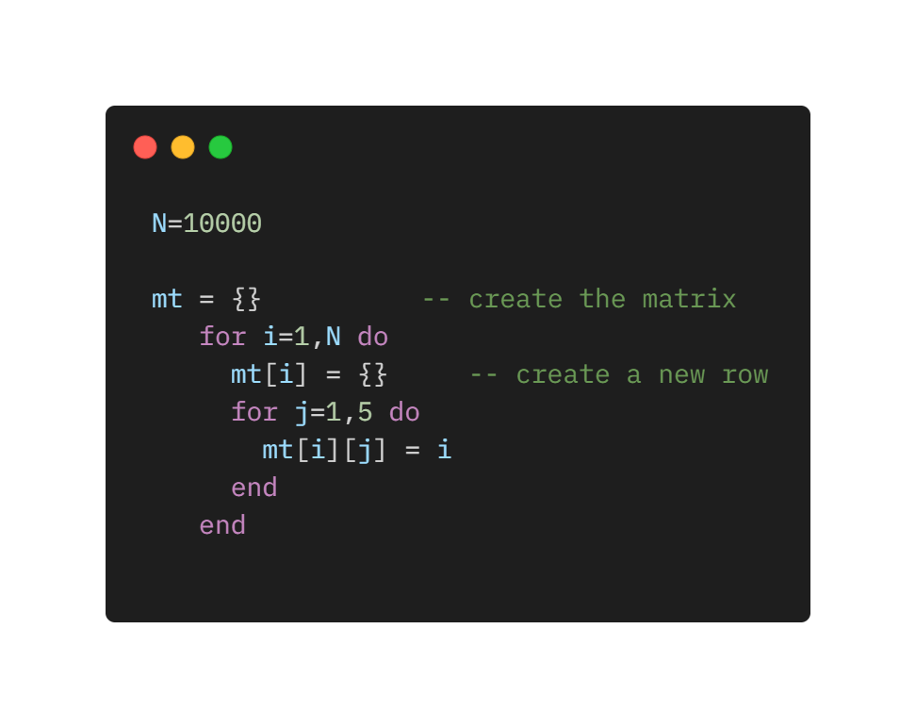
Is this way of defining matrices convinient?
Quite often, applications use a sparse matrix, a matrix wherein most elements are 0 or nil.
To represent a graph with an adjacency matrix with ten thousand nodes, where each node has about five neighbors, you will need a matrix with a hundred million entries (a square matrix with 10,000 columns and 10,000 rows), but approximately only fifty thousand of them will not be nil.
There are many techniques to save space, but using Lua they are not necessary. Arrays are represented by tables, they are naturally sparse!
With matrices implemented as tables of tables, ten thousand tables tables are necessary, each one with about five elements, with a grand total of fifty thousand entries.

Slide 27
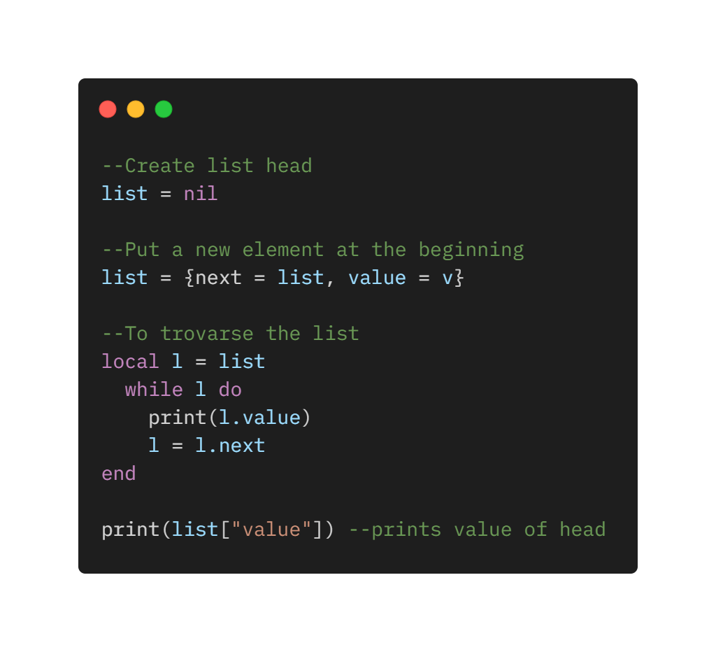
Linked Lists
Because tables are dynamic entities, it is easy to implement linked lists in Lua. Each node is represented by a table and links are simply table fields that contain references to other tables.
It is very easy to implement them, and the value can of course be another table, complex as needed.

Slide 28
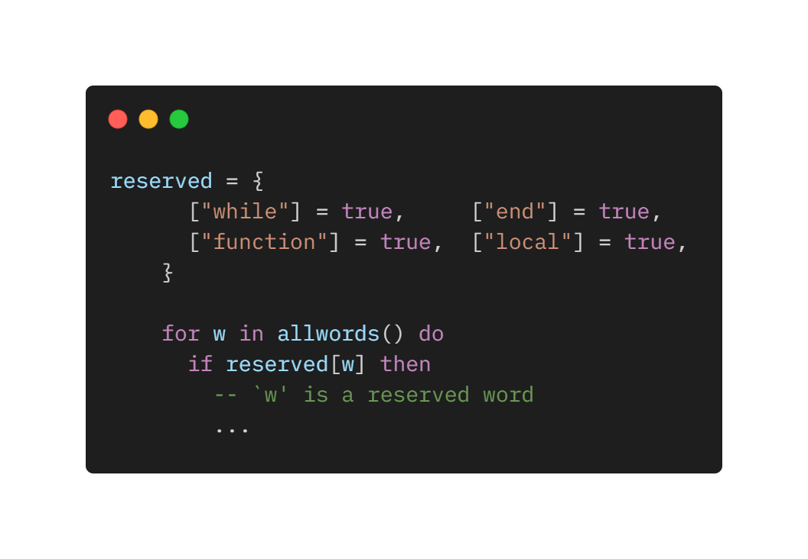
Sets
Suppose you want to list all identifiers used in a program source; somehow you need to filter the reserved words out of your listing. Some C programmers could be tempted to represent the set of reserved words as an array of strings, and then to search this array to know whether a given word is in the set. To speed up the search, they could even use a binary tree or a hash table to represent the set.
In Lua, an efficient and simple way to represent such sets is to put the set elements as indices in a table. Then, instead of searching the table for a given element, you just index the table and test whether the result is nil or not.

Slide 29
Metamethods

Slide 30
Arithmetic metamethods

Slide 31
What I Implemented
Basic data type:
Number (Double, Integer)
Table (1-D canonical array)
Fixed size based on declaration: a={2, 3, 4, 5} can have at most that size
Variables:
Global variables (not inside functions)
Single and multiple definition and initialization
Local variables (only in functions and flow control instructions and local scopes)
2.1. Single and multiple definition
2.2. Single and multiple definition and inline initialization
3. Reassignment of global and local variables (within same type)
Operators:
Arithmetic
Sum +
Subtraction –
Multiplication *
Dision /
Exponentiation ^ (of immediates through ^ operatore, with math.pow(x, y) for anything)
Logical
AND and
OR or
NOT not (not implemented)
Relational
Equality
Inequality
Less than
Greater than
Less than or equal
Greater than or equal
Flow Control Instructions:
For loop
While loop
Repeat-until
If then else
Nested Flow Control Instruction (any depth and all)
Loop Condition Supported: Single numbers, single variables, Boolean expressions (of any length), single array elements, mathematical expressions.
Functions:
Function declaration (anywhere in the code) (only NUMBER as parameter and return value must be a NUMBER)
Print function (Only string or only multiple numbers/variables)
Print(string.format()) (c-like printf) Inclusion of external modules though require keywork (function must be called with name.function)
“require” function implemented. It is possible to import file (libraries) and used them through library.namefunction(). Support also for global variables declared in libraries and error in case of multiple declarations.
Semantic error supported:
Variable not declared
Operation not supported by compiler(NOT)
Redeclaration of a variable into an array (limitation of compiler)
Array access to array not declared
Array access to variable (not array)
Redeclaration of function
Invocation of function not declared
Wrong number of parameters to function
Syntactical warning supported:
Error in if condition
Error in assignment of a variable
Missing } in array declaration
Missing ) in function declaration
Missing return value of a function
Syntactical error supported
Expression between () not correct
Wrong variables list
Wrong loop variable initialization
Assign an array to a variable and vice versa
Declaration of global variables inside functions (Compiler limitation)
Print function without parameters
Pass an array to a function (Compiler limitation)
Duplication of require of a file

Slide 32
References
Programming in Lua
by Roberto Ierusalimschy Lua.org, December 2003 ISBN 8590379817

Slide 33
Creative process Icons
Performing Arts Icons

Slide 34
Nature Icons

Slide 35
SEO & Marketing Icons

Slide 36


